Slide 1
Methods and Policy Implications
The Social Cost of Carbon :
Presented by:
Aditya Jagdale
Vishal Singh
Naman Agnihotri
Shashank Singh

Slide 2
Social Cost of Carbon (SSC)
“Economic measure that estimates the monetary value of the damages caused by emitting one additional metric ton of carbon dioxide into the atmosphere.”
Introduced by: Obama administration (2010)
Developed by: Interagency Working Group (IWG)
It reflects the present value of future costs linked to climate change.
Notes:
Introduced by: Obama administration (2010) Developed by: Interagency Working Group (IWG), a team of economists and scientists from multiple federal agencies.
It reflects the present value of future costs linked to climate change.
By translating these damages into a dollar figure, the SCC provides us with a tool to evaluate the benefits of reducing emissions.

Slide 3
Steps for calculating SSC
According to Resource For Future(RFF), estimates of the SCC are calculated in four steps using specialized computer models.
Step 1: Project future emissions
Step 2: Model future climate responses
Step 3: Assess the impacts
Step 4: Convert future damages into their present-day values
Notes:
Step 1: Project future emissions based on population, economic growth, and other factors.
Step 2: Model future climate responses, such as temperature increase and sea level rise.
Step 3: Assess the impacts that these climatic changes will have on economic and social outcomes like agriculture, human health, energy use, and damage to coastal infrastructure.
Step 4: Convert future damages into their present-day values and add them up to determine total damages.

Slide 4
Social Cost of Carbon (SSC)
For Example:
Let the SCC is estimated at $51 per ton of CO₂.
If a new power plant is expected to emit 1 million tons of CO₂ annually,
the total annual climate damage is:
1,000,000×51=$51,000,000.
This means the plant’s emissions would cause $51 million worth of future damages (health costs, agricultural losses, flood risks, etc.).
We can use this estimate to decide whether stricter emission controls, renewable investments, or carbon pricing would be more cost-effective.

Slide 5
Impacts
The SCC in the U.S. is a decision-making tool for the government
Regulatory Impact Analysis
Infrastructure and Federal Projects
Policy Design & Justification
Legal and Court Cases
Notes:
The SCC in the U.S. is a decision-making tool for the government. It translates tons of CO₂ into dollar damages so policymakers can weigh climate costs vs. economic costs of regulations and projects.
1. Regulatory Impact Analysis
Federal agencies (like the EPA, Department of Energy, Department of Transportation) must evaluate the costs and benefits of new rules.
📌 2. Infrastructure and Federal Projects:This helps compare projects fairly — e.g., a renewable energy project shows avoided SCC damages compared to fossil fuel projects.
3. Legal and Court Cases
U.S. courts have required agencies to consider climate damages in environmental reviews (under the National Environmental Policy Act, NEPA).
Agencies often use SCC to quantify these damages, since ignoring them can lead to lawsuits.
📌 4. Policy Design & Justification
SCC helps justify climate policies Without SCC, benefits of emission cuts would look “too small” compared to compliance costs. SCC ensures climate benefits are properly valued.
📌 5. Current Value in the U.S.
Interim federal estimate: $51 per ton of CO₂ (at a 3% discount rate, 2021 update).
Discount rate: present value of future money
The Biden administration has asked agencies to update SCC using newer science → estimates may rise to $100+ per ton.

Slide 6
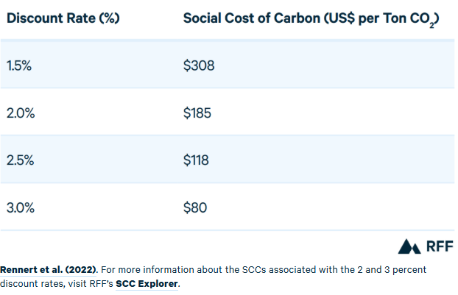
SCC with different discount rates
Notes:
The SCC in the U.S. is a decision-making tool for the government. It translates tons of CO₂ into dollar damages so policymakers can weigh climate costs vs. economic costs of regulations and projects.
1. Regulatory Impact Analysis
Federal agencies (like the EPA, Department of Energy, Department of Transportation) must evaluate the costs and benefits of new rules.
📌 2. Infrastructure and Federal Projects:This helps compare projects fairly — e.g., a renewable energy project shows avoided SCC damages compared to fossil fuel projects.
3. Legal and Court Cases
U.S. courts have required agencies to consider climate damages in environmental reviews (under the National Environmental Policy Act, NEPA).
Agencies often use SCC to quantify these damages, since ignoring them can lead to lawsuits.
📌 4. Policy Design & Justification
SCC helps justify climate policies Without SCC, benefits of emission cuts would look “too small” compared to compliance costs. SCC ensures climate benefits are properly valued.
📌 5. Current Value in the U.S.
Interim federal estimate: $51 per ton of CO₂ (at a 3% discount rate, 2021 update).
Discount rate: present value of future money
The Biden administration has asked agencies to update SCC using newer science → estimates may rise to $100+ per ton.

Slide 7
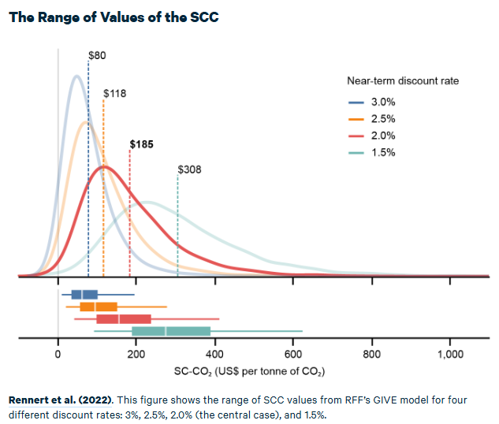
SCC with different discount rates
Notes:
The SCC in the U.S. is a decision-making tool for the government. It translates tons of CO₂ into dollar damages so policymakers can weigh climate costs vs. economic costs of regulations and projects.
1. Regulatory Impact Analysis
Federal agencies (like the EPA, Department of Energy, Department of Transportation) must evaluate the costs and benefits of new rules.
📌 2. Infrastructure and Federal Projects:This helps compare projects fairly — e.g., a renewable energy project shows avoided SCC damages compared to fossil fuel projects.
3. Legal and Court Cases
U.S. courts have required agencies to consider climate damages in environmental reviews (under the National Environmental Policy Act, NEPA).
Agencies often use SCC to quantify these damages, since ignoring them can lead to lawsuits.
📌 4. Policy Design & Justification
SCC helps justify climate policies Without SCC, benefits of emission cuts would look “too small” compared to compliance costs. SCC ensures climate benefits are properly valued.
📌 5. Current Value in the U.S.
Interim federal estimate: $51 per ton of CO₂ (at a 3% discount rate, 2021 update).
Discount rate: present value of future money
The Biden administration has asked agencies to update SCC using newer science → estimates may rise to $100+ per ton.

Slide 8
USA: A Case Study

Slide 9
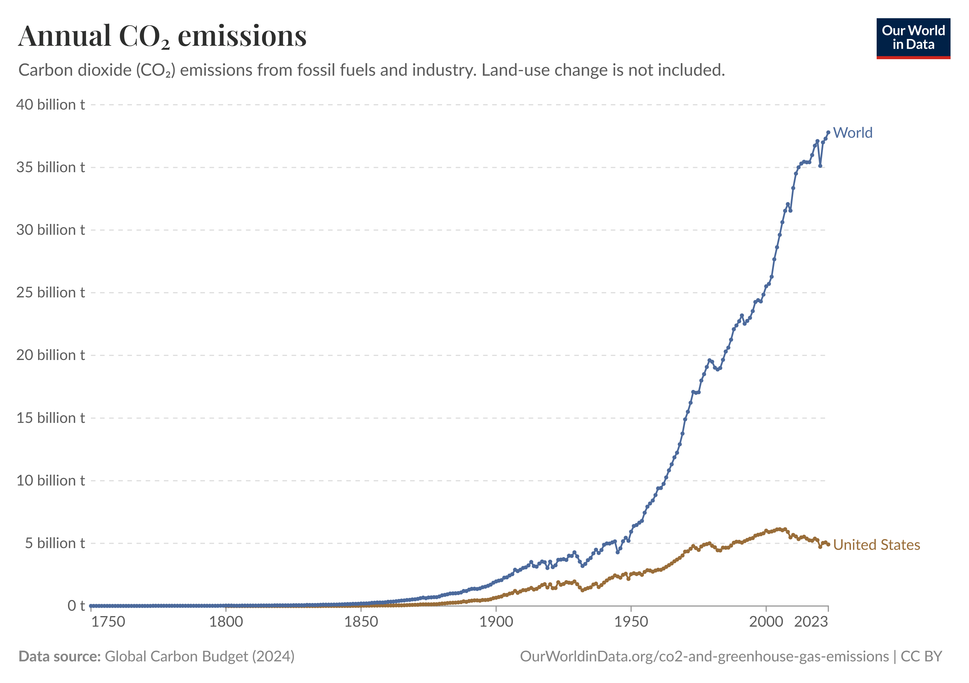

Slide 10
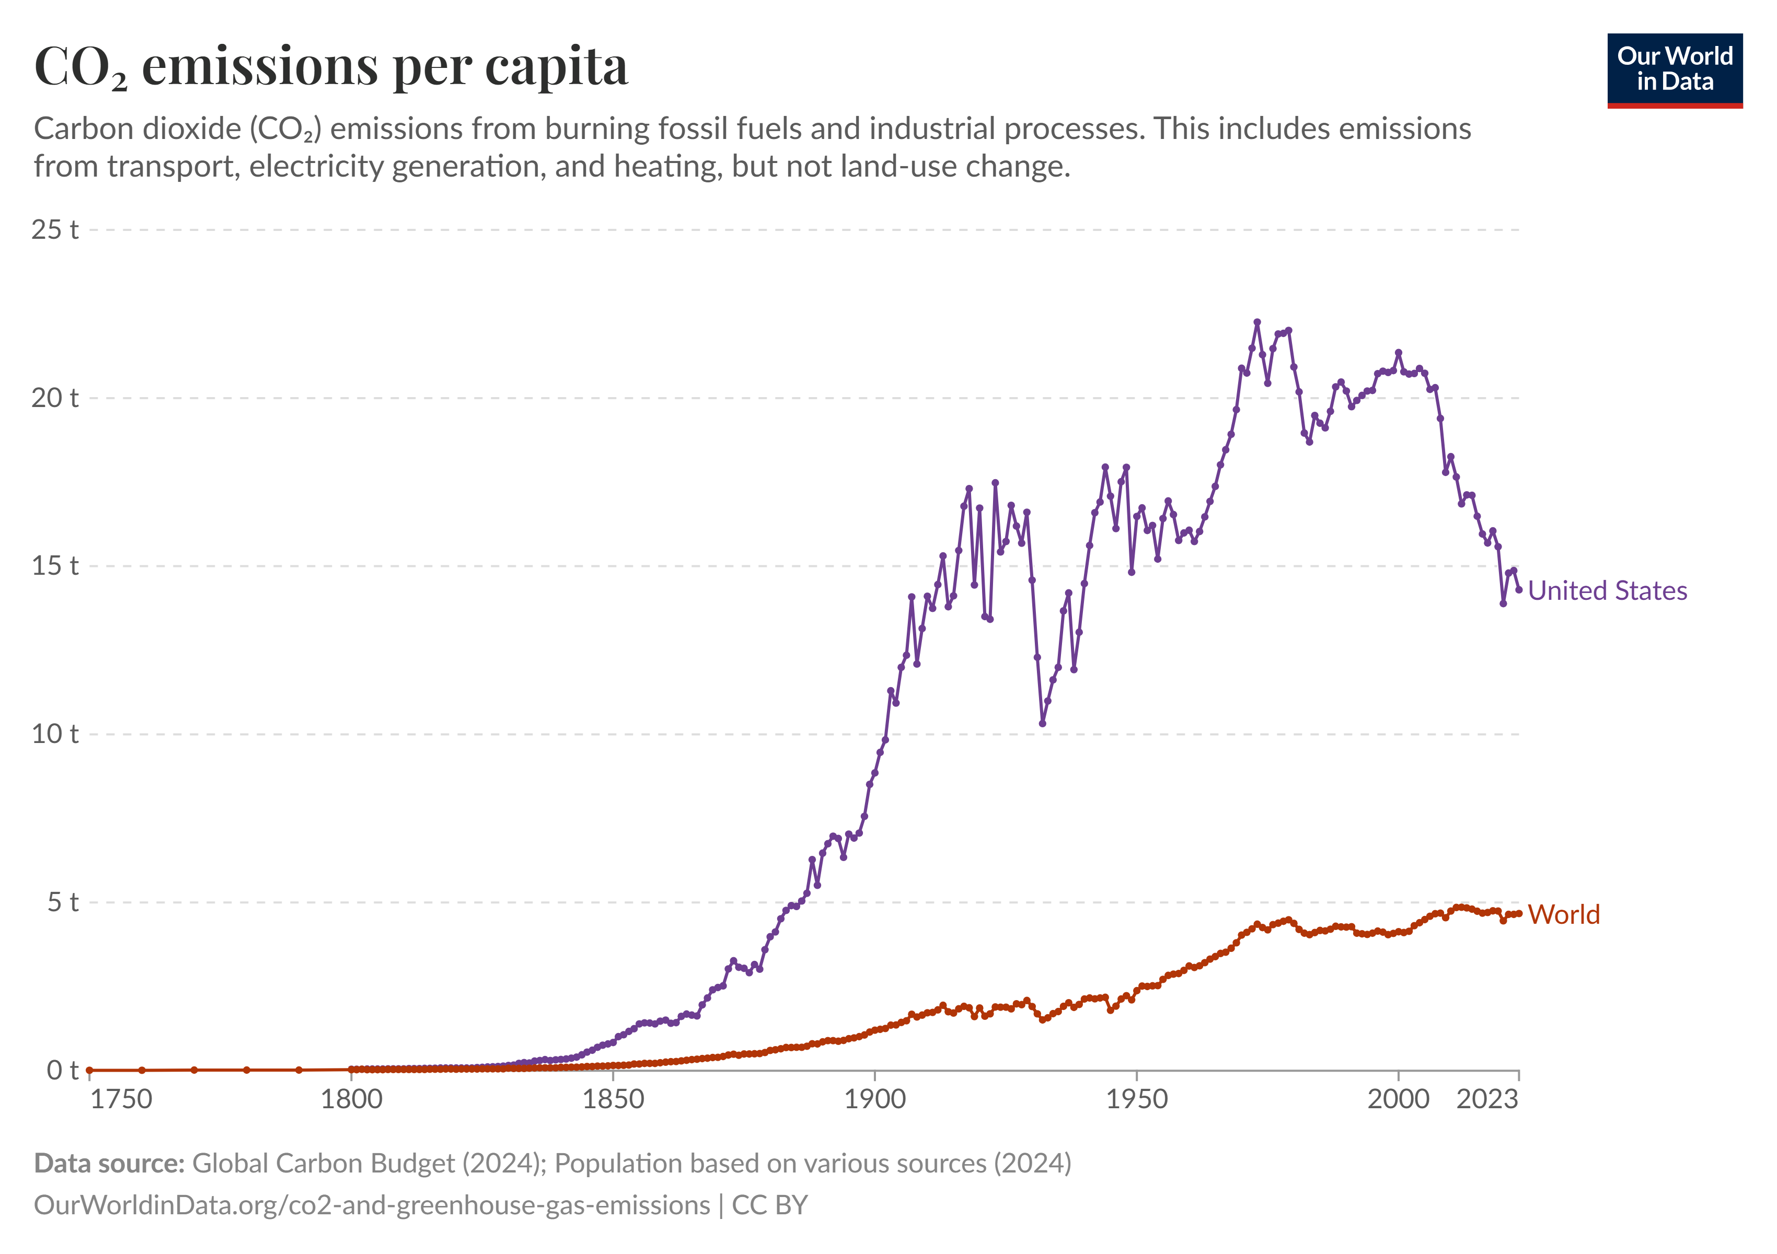

Slide 11
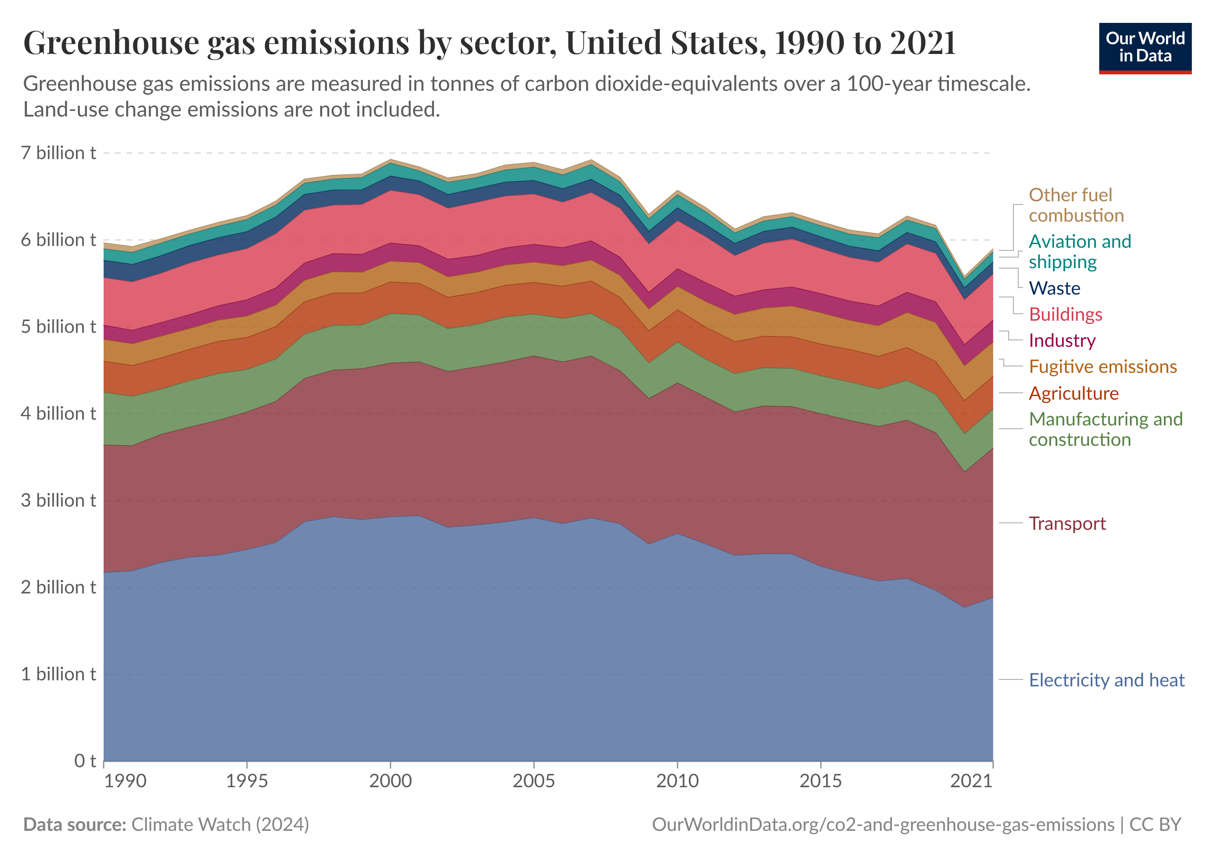

Slide 12
Timeline of Social Cost of Carbon(SCC) in USA

Slide 13
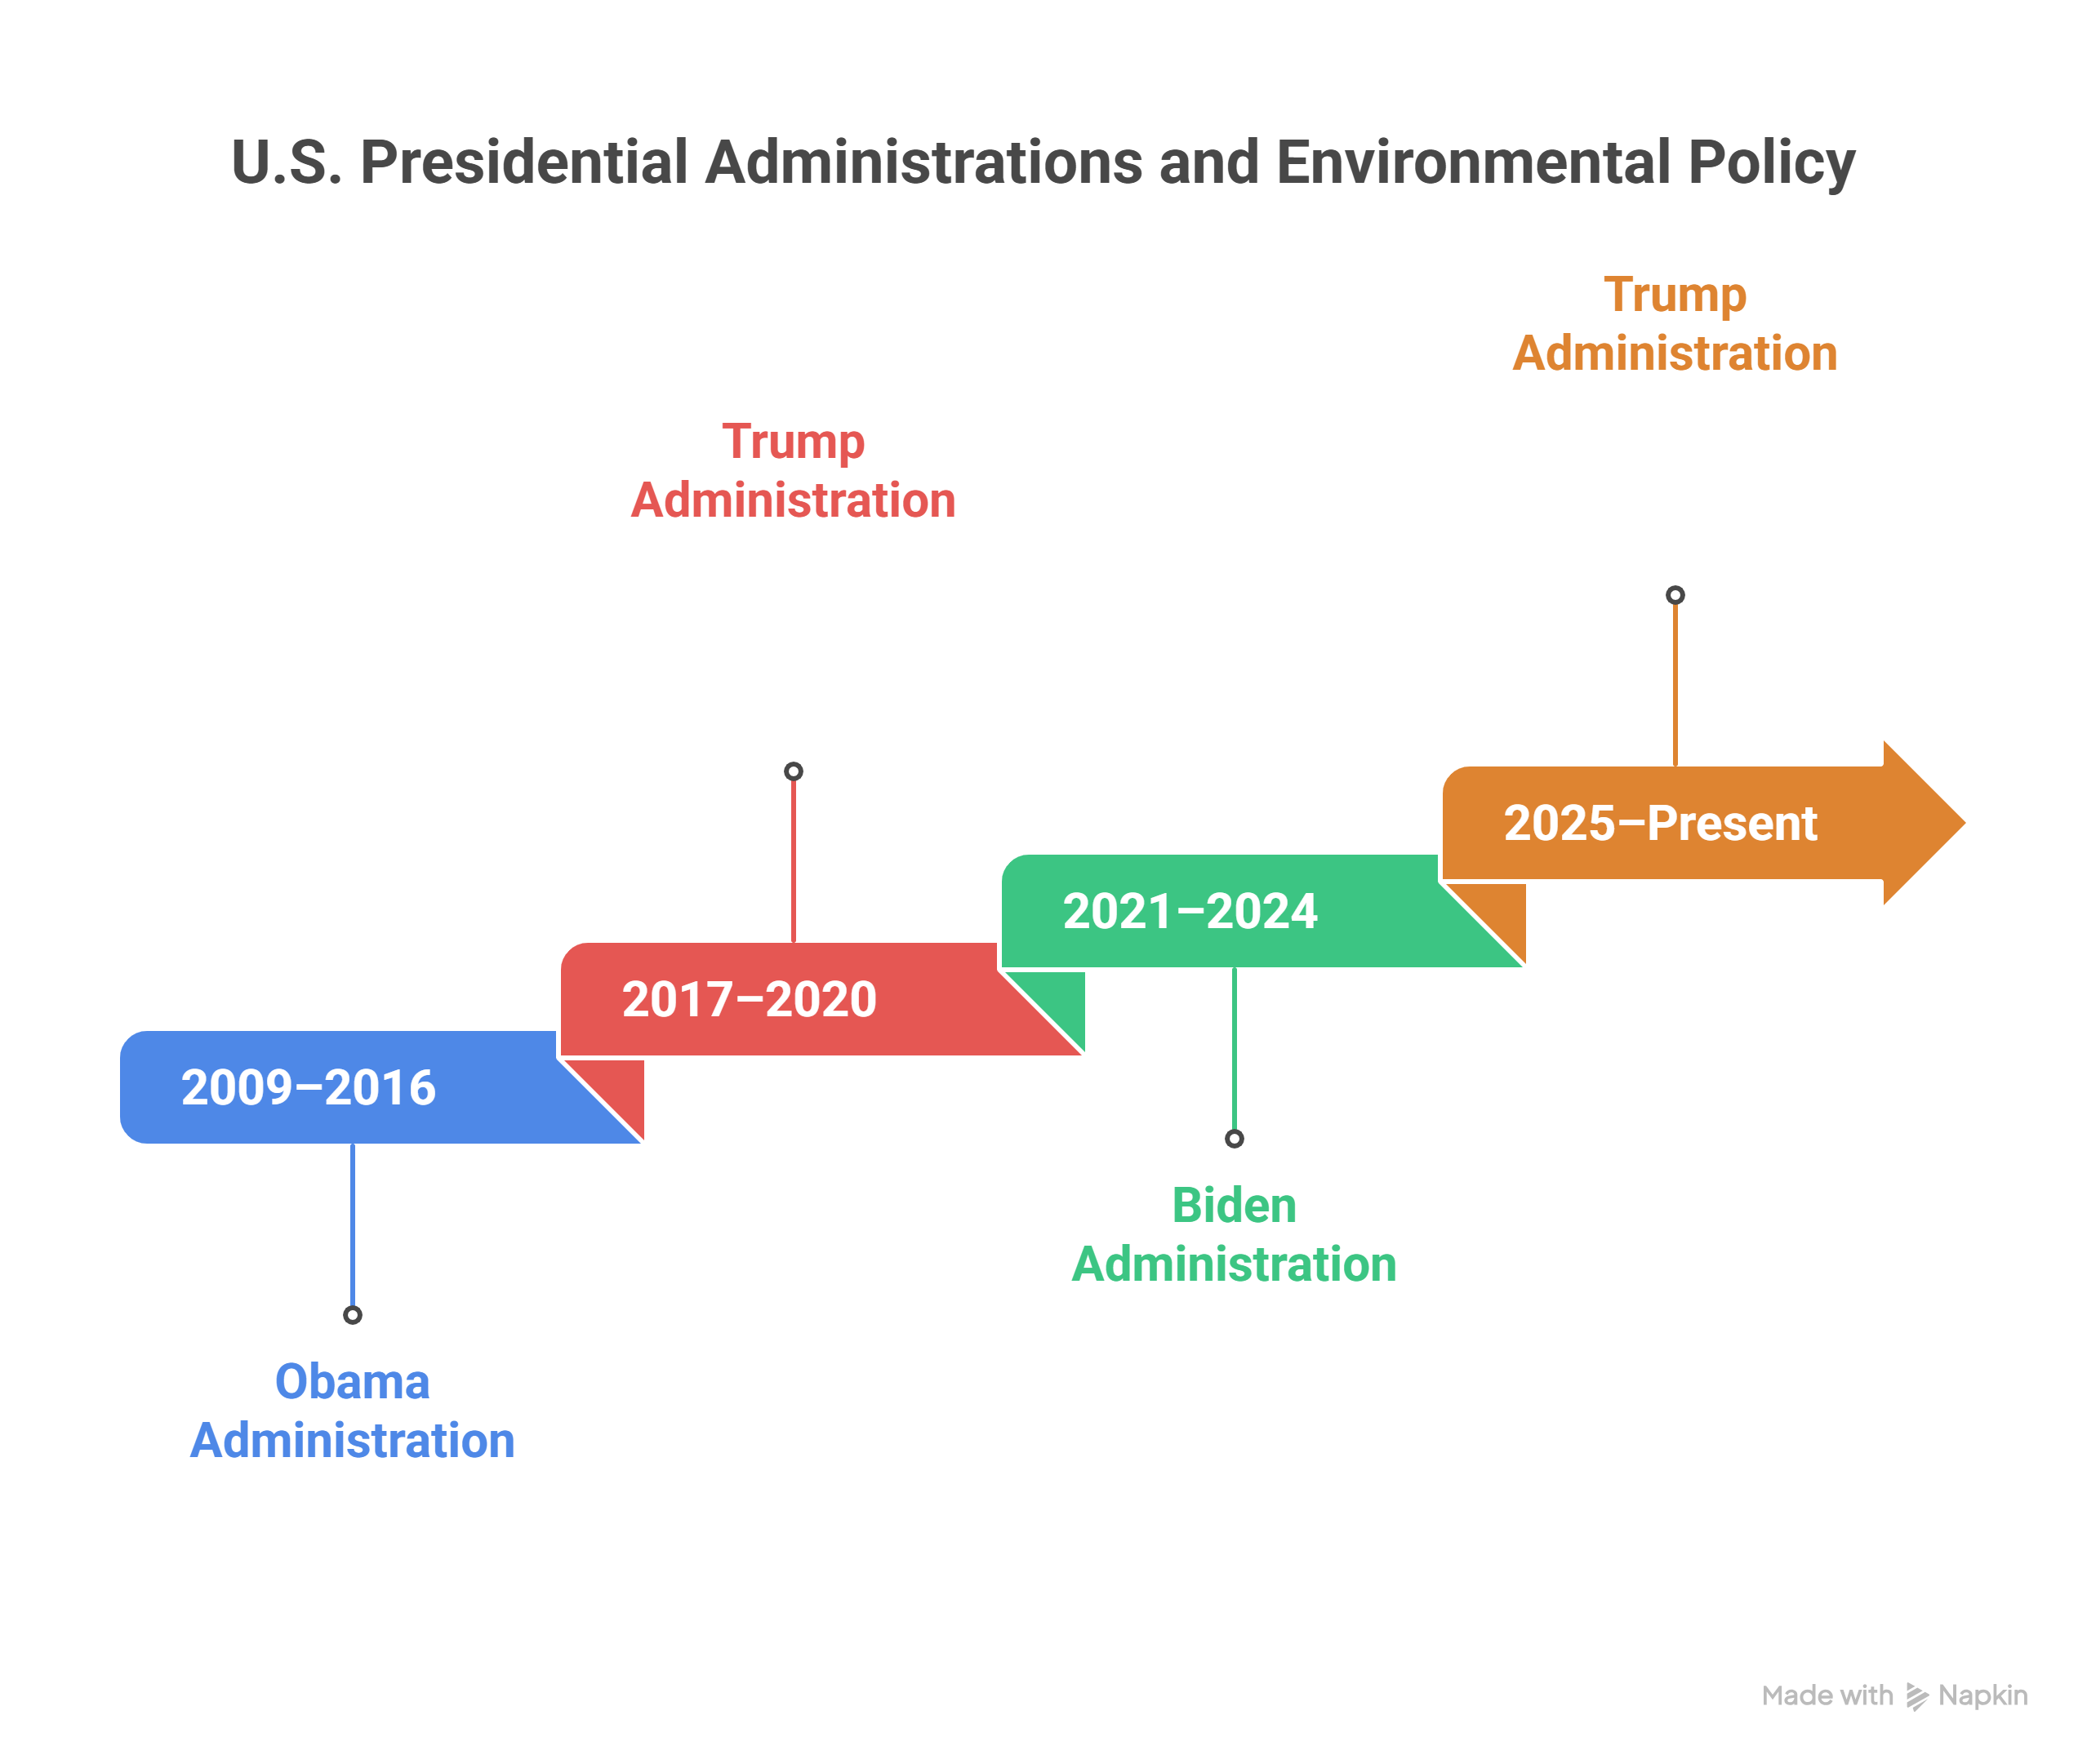

Slide 17
US $ 41/tCO₂
2009–2016: The Obama Administration
IWG's estimate for the SCC :

Slide 18
2009–2016: The Obama Administration
Formal Adoption in Federal policy making.
Creation of Interagency Working Group (IWG).
Key Estimate:
IWG Estimate: 41/t CO₂ SCC used in cost–benefit analyses for fuel efficiency and power plant regulations.

Slide 19
US $ 1-7/tCO₂
2017–2020: The Trump Administration
Estimate for the SCC :

Slide 20
2017–2020: The Trump Administration
Disbanded the IWG.
Reduced SCC:
Focused on domestic damages, ignoring global impacts.
Using higher discount rates (3-7%).
Policy Impact:
Weakened economic justification for new climate regulations.

Slide 21
US $ 51/tCO₂
2021–2024: The Biden Administration
Estimate for the SCC :

Slide 22
US $ 190/tCO₂
2021–2024: The Biden Administration
Estimate Proposed by Environmental Protection Agency (EPA):
Not adopted

Slide 23
2021–2024: The Biden Administration
Reinstatement of the IWG.
Interim Estimate: $51/ton SCC applied for regulatory analysis pending update.
Comprehensive Review:
RFF’s GIVE Model (Rennert et al., 2022): $185/ton CO₂
EPA (Environmental Protection Agency) Update, 2023: Adopted RFF findings, raising SCC to $190/ton CO₂.
Notes:
RFF-Berkeley Greenhouse Gas Impact Value Estimator (GIVE) model

Slide 24
2025–Present: The Trump Administration
SCC Discontinued: Unless legally required.
Deregulation Focus: Seen as limiting economic growth and energy production.
Impact on Policy: Weakened EPA ability to justify emission rules.

Slide 25
SCC as a Guide for Indian Policy & Investment

Slide 26
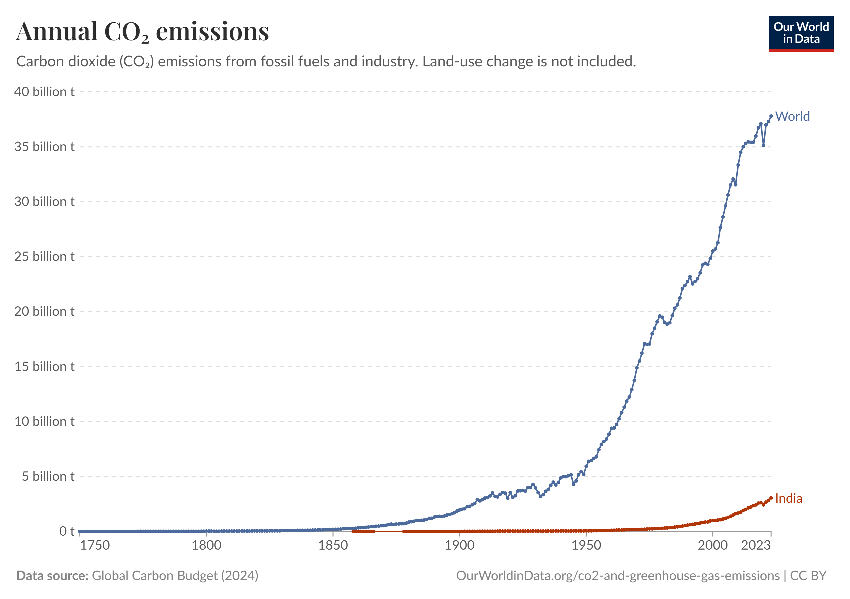
3.06 bt

Slide 27
Indian Situation: Current Landscape
India’s climate policy must balance growth and sustainability, while learning from global practices like the USA’s use of SCC.
Emissions Profile : India is the 3rd largest emitter, but per capita emissions remain far below USA levels
Development Priorities: Growth, poverty reduction, and energy access complicate climate policy.
Energy Dependence: Heavy reliance on coal for electricity generation.
International Standing: Using SCC strengthens India’s role in global climate negotiations.

Slide 28
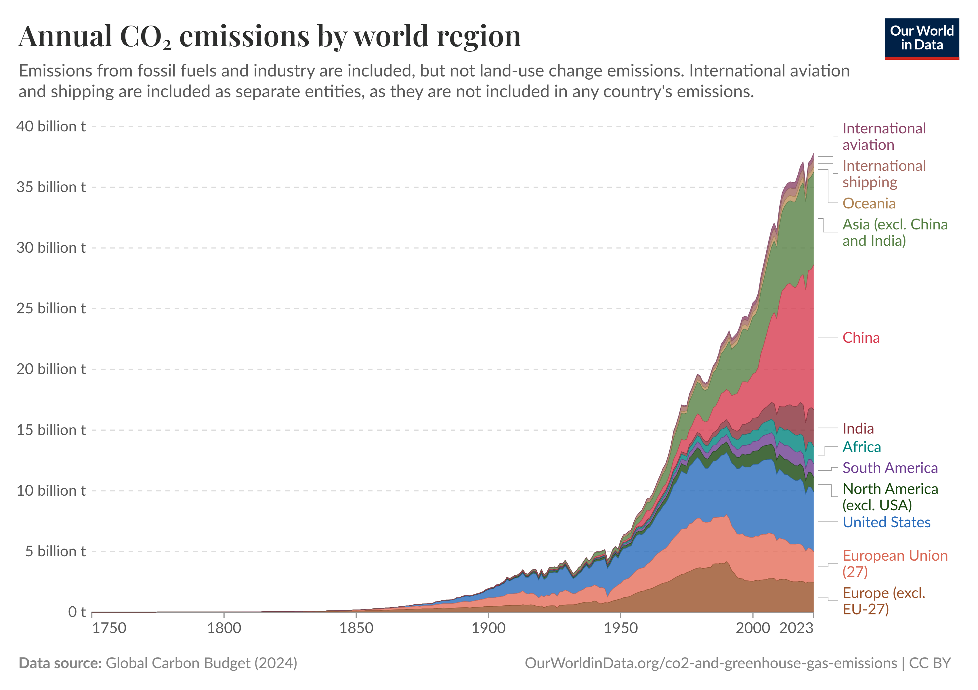
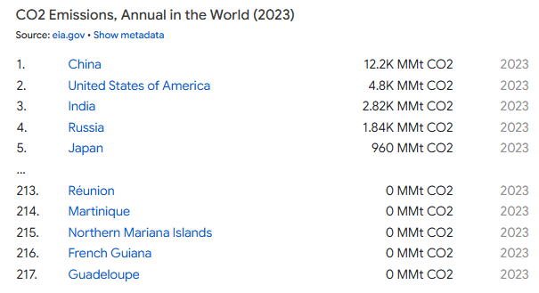

Slide 29
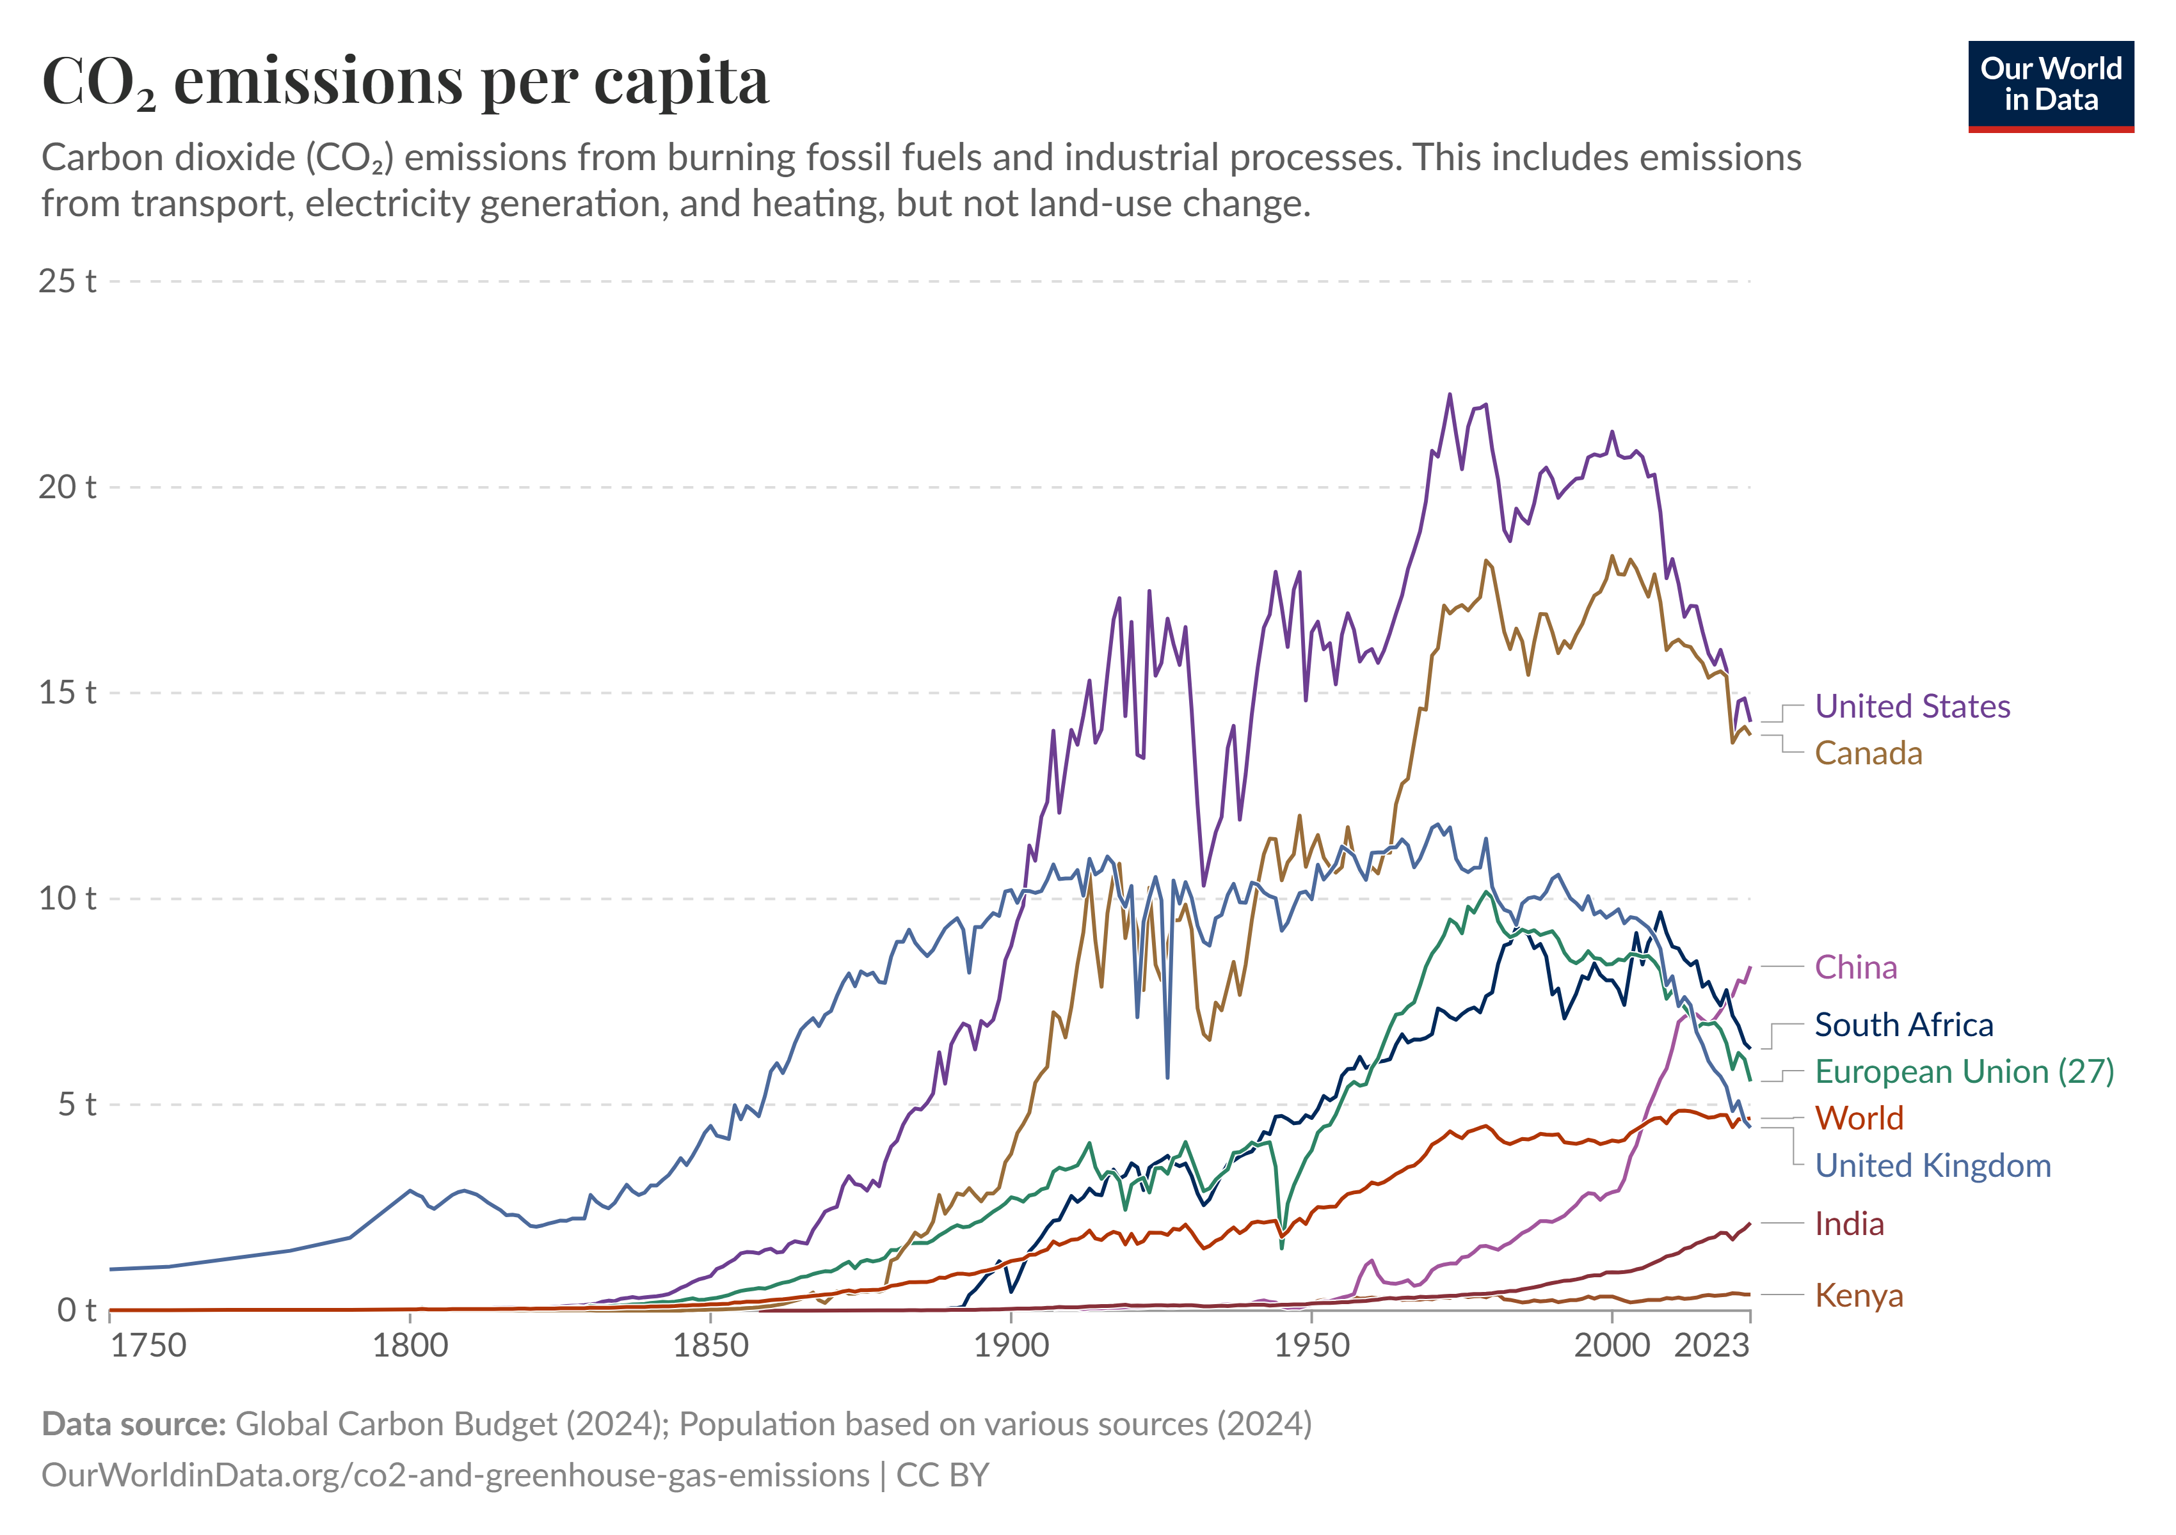

Slide 30
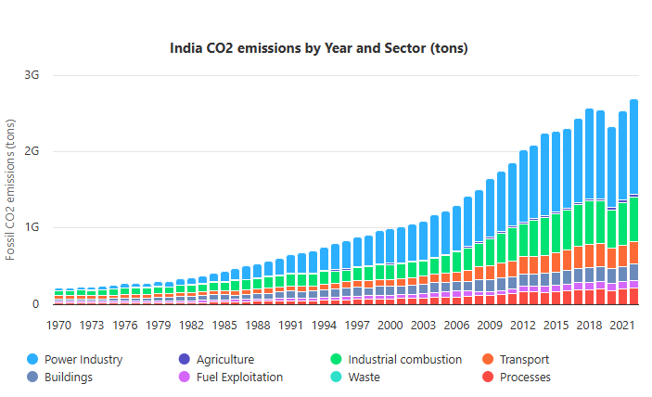
Energy Dependence: Heavy reliance on coal for electricity generation.

Slide 31
US$80-130/tCO₂
Estimate by National Bureau of Economic Research (NBER), United States (US) for India-

Slide 32
US$2.9/tCO₂
Estimate as seen in Economic Survey 2016-17
2015 estimate.
No data available after that.
Notes:
The document begins by citing Nobel Laurette William Nordhaus who estimated India’s SCC at about US$2.9/tCO2 in 2015 and then proceeds to compare the social cost of coal with the social cost of renewables (RE).
To calculate SCC, the Interagency Working Group (IWG) pools the outputs from three different Integrated Assessment Models (IAMs).
DICE (Dynamic Integrated Climate-Economy model) is developed by William Nordhaus, a professor of economics at Yale University. FUND (Framework for Uncertainty, Negotiation and Distribution model) was originally developed by Richard Tol, a professor at the University of Sussex, but is now co-developed by Tol and David Anthoff, assistant professor at the University of California. PAGE (Policy Analysis of the Greenhouse Effect model) is developed by Chris Hope from the University of Cambridge, UK.

Slide 33
Implementing SCC in India
The Social Cost of Carbon (SCC) can provide India with a structured tool to guide investments and regulations in line with climate goals.
Policy Appraisal – Integrate SCC into cost–benefit analysis of infrastructure, energy, and transport projects.
Carbon Pricing – Use SCC as a reference for taxation and industry benchmarks.
Targeted Incentives – Apply SCC to guide subsidies for renewables and efficiency, with periodic revisions.

Slide 34
Limits : Using SCC as a Guide
Transplanting the SCC framework into India overlooks critical differences in context, economy, and development needs.
Economic Constraints – Lower per capita income and fiscal limits make US-level SCC difficult to apply.
Coal & Energy Poverty – Strict SCC-based policies could undermine affordability and access
Long-Term Lag – Benefits take years to emerge, and a uniform SCC overlooks state-level disparities

Slide 35
Should SCC Analysis Replace Mitigation Cost Analysis?

Slide 36

Mitigation Cost Analysis
Calculates expenses of cutting emissions, showing efficient pathways to targets but not assessing overall economic justification.

Slide 37
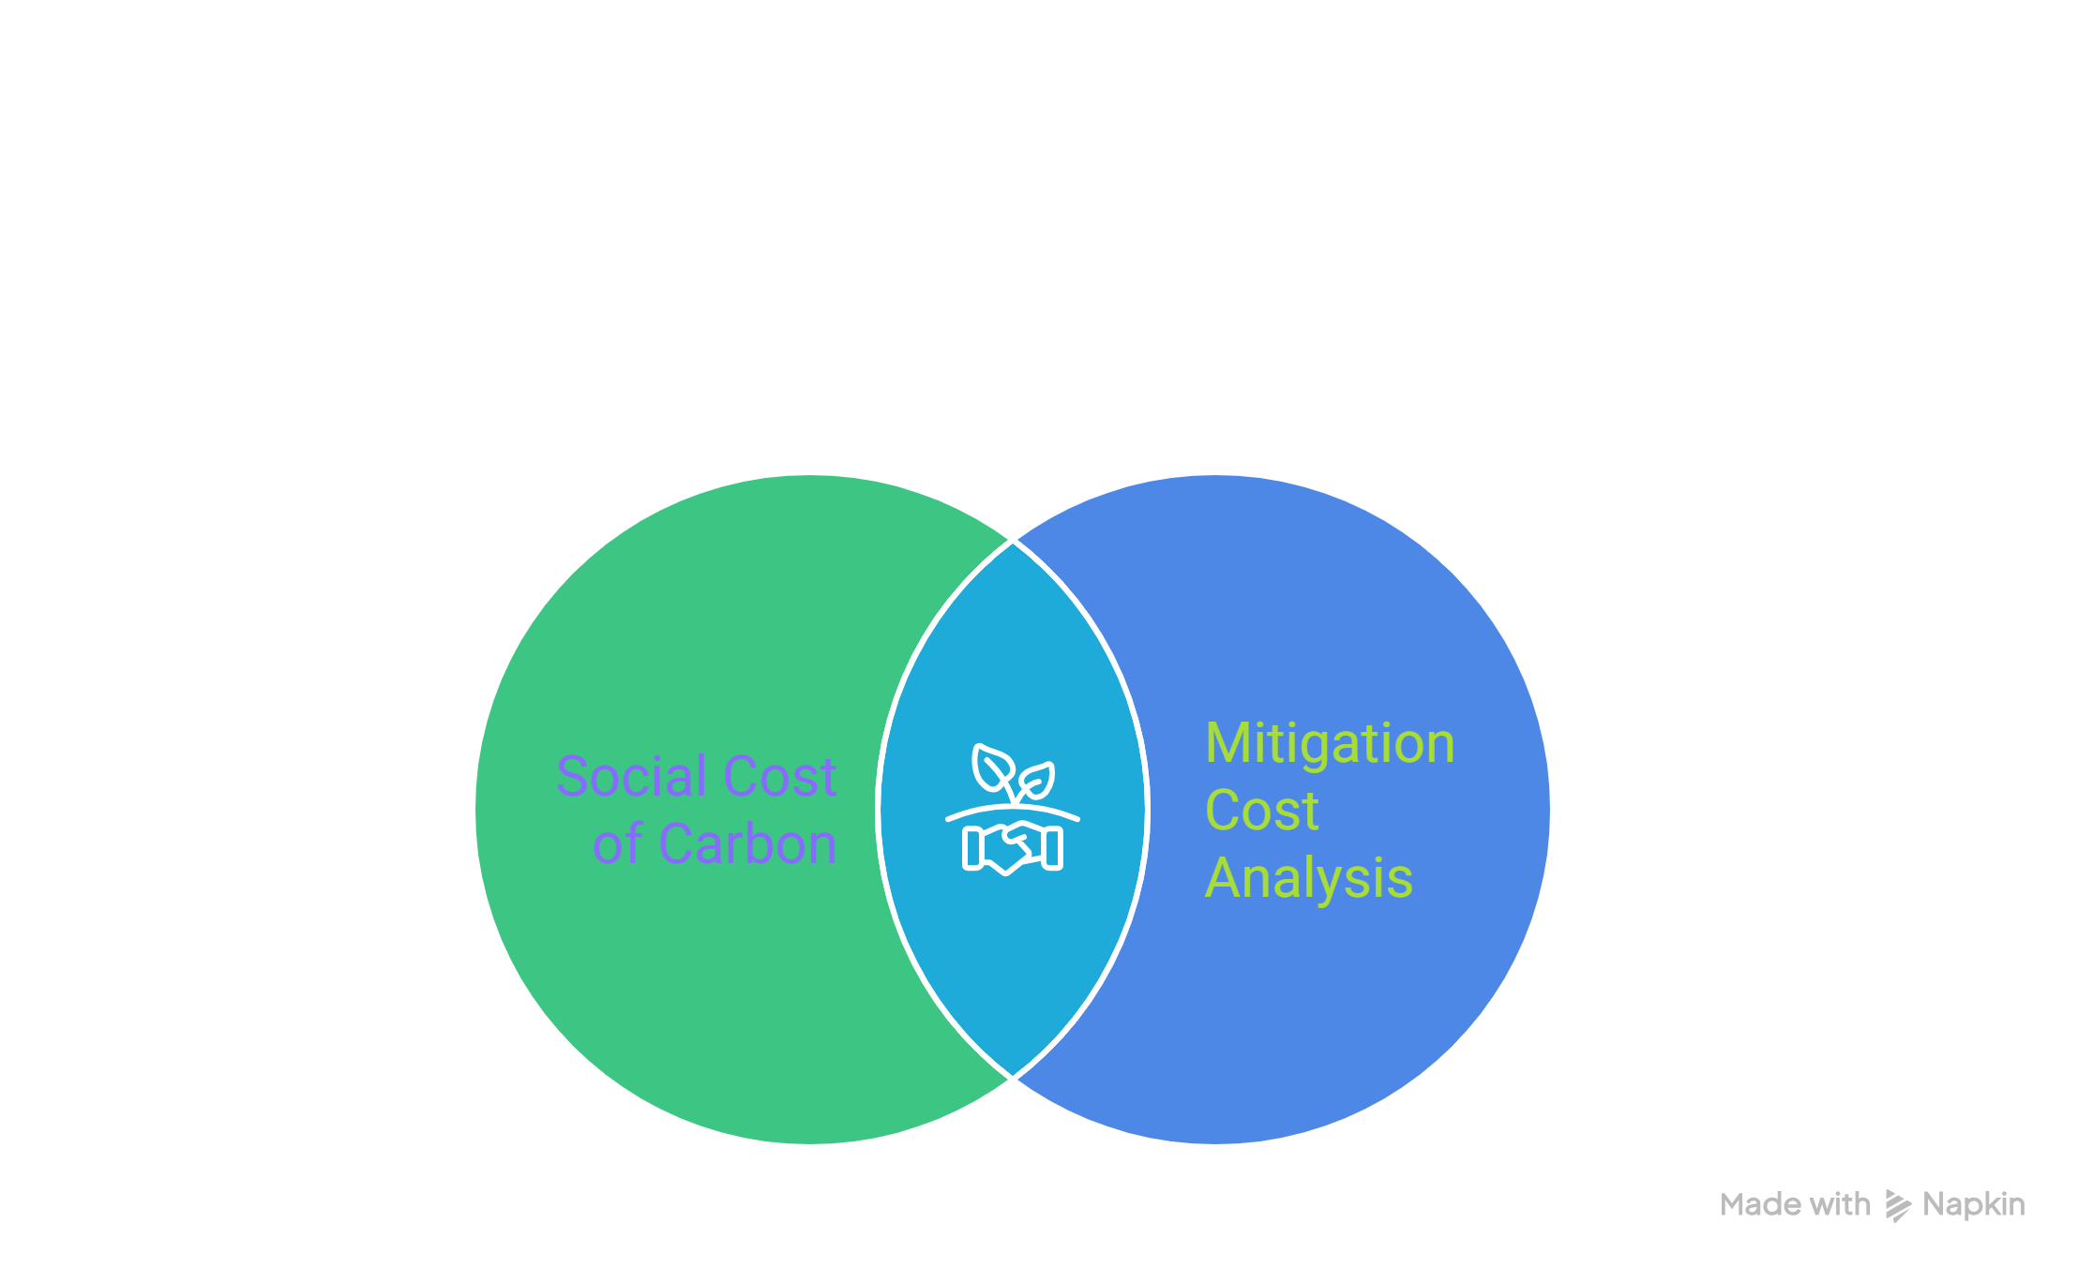
No, they are complementary, not interchangeable.

Slide 38
Should SCC Analysis Replace Mitigation Cost Analysis?
SCC and mitigation cost analysis are complementary, not interchangeable. SCC captures the benefit side by valuing avoided damages from emissions cuts, while mitigation cost analysis shows the cost side, identifying efficient reduction pathways.
Together, they form a complete cost–benefit framework, ensuring climate policies are both effective and worthwhile.

Slide 39
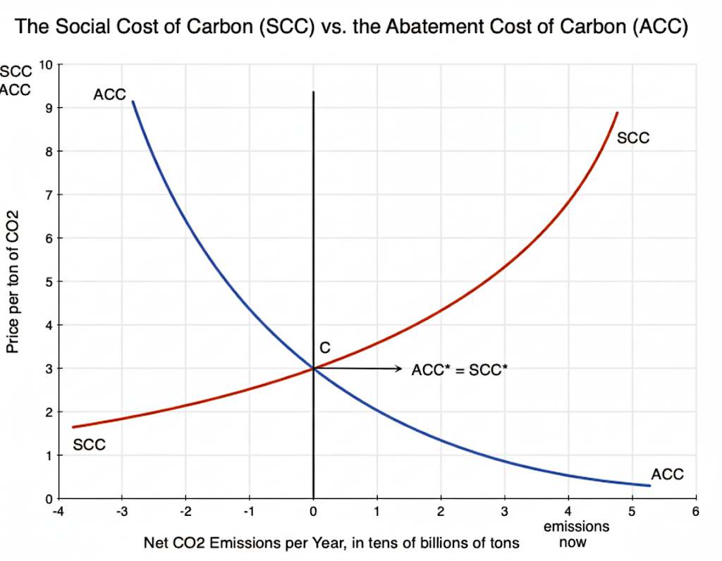

Slide 40
References
https://19january2017snapshot.epa.gov/climatechange/social-cost-carbon_.html
https://aneconomicsense.org/2023/09/04/estimating-the-social-cost-of-carbon/
https://www.rff.org/publications/data-tools/scc-explorer/
https://www.orfonline.org/expert-speak/social-cost-of-carbon-as-a-policy-tool-challenges-in-the-indian-context#:~:text=A%20paper%20that%20analysed%20the,cost%20of%20US$%204.6%20billion.
https://climateactiontracker.org/countries/india/targets/
https://ourworldindata.org/co2-emissions
https://www.epa.gov/
https://ourworldindata.org/emissions-by-sector
https://www.indiabudget.gov.in/economicsurvey/

Slide 41
Thank You
Any Questions?

